Slide 1
TRAVEL SAFE using PYTHON
Internal Guide:
Mrs. A. Lalitha Venkatesan
Project Members:
Kavya Reddy. V (12R11A05E5)
Vaishnavi. V (12R11A05G7)

Slide 2

Travel Safe is an online web application
TRAVEL SAFE
-
X
www.travelsafe.com

Slide 3
ABSTRACT
It is an attempt to create a safe and tension-free ride for the user.
The user’s location can be traced by scanning the QR CODE of the cab or the bus depending on the mode
of transport.
The user has to log into his account and scan the QR CODE of the vehicle whenever he is travelling.
Whenever the user is in trouble, their friends can just check the last QR CODE scanned which will give them
access to the driver and vehicle details. Using this, the location of the user can be traced.
The application also has an SOS option where a message will be sent to their friends when a button is clicked.

Slide 4
Existing System and Proposed System
Applications for ensuring the safety of the traveller do exist but none of them have the function of scanning the QR code.
This scanning of QR Code gives the details of the driver and the vehicle making the tracking process simple.

Slide 5
We have tried a new way for the user to access his friend’s scanned details.
If the user is in danger, his friends can access the latest vehicle details which makes it easier for him to trace the user’s location.
To access the vehicle details, he has to login with his number and the common password that he shares with the user.
Similarly if he wants to access other user, (for example user Y’s) scanned details.. Then he has to login with his phone number and the common password that he shares with user Y.
This gives him access only to that page where the scanned details are stored and not to the home page of the user.

Slide 6
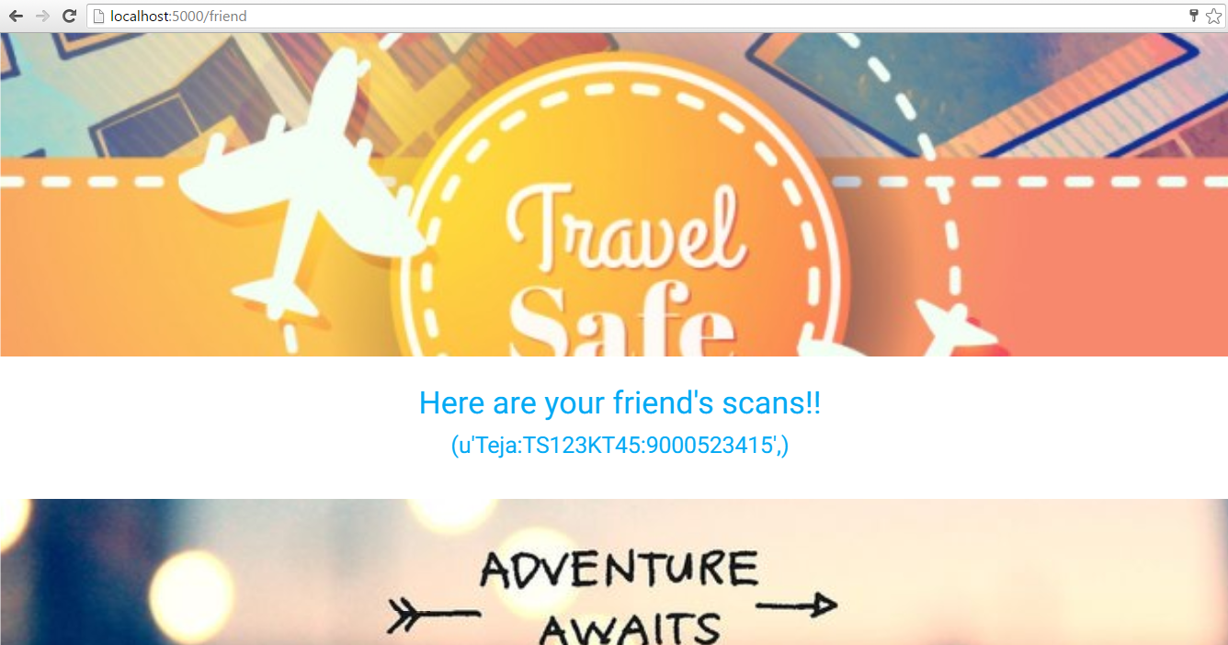

Slide 7
Use Case diagram
Logs in
Scans the QR code
database
Checks friend’s records
Checks his previous records
user
friend
Sends SOS
Checks map
GPS

Slide 8
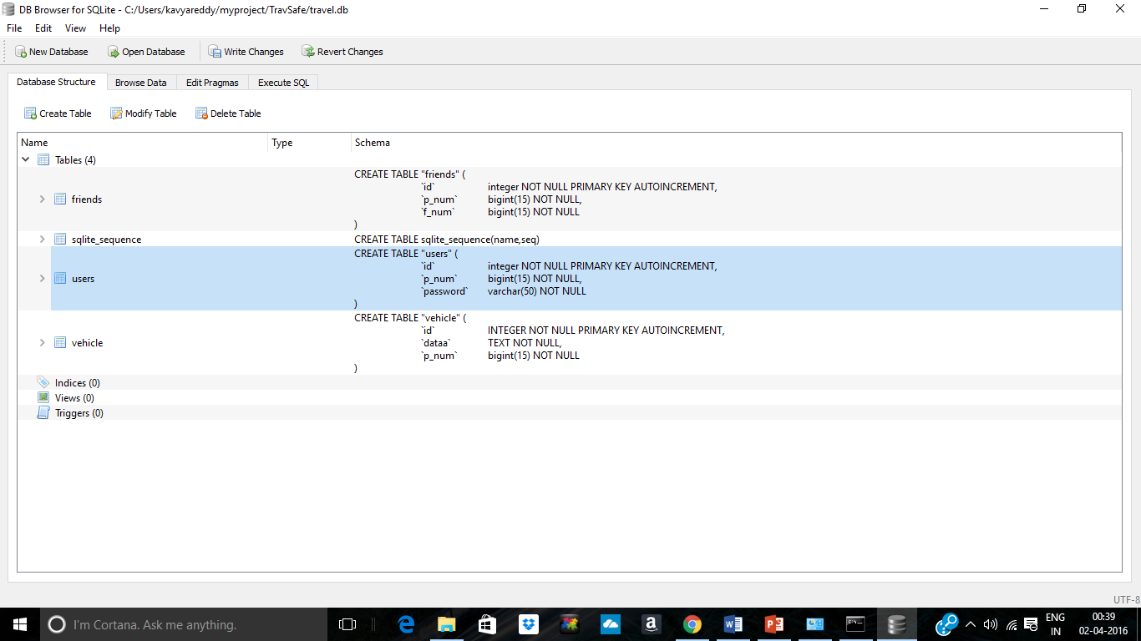
Database Structure

Slide 9
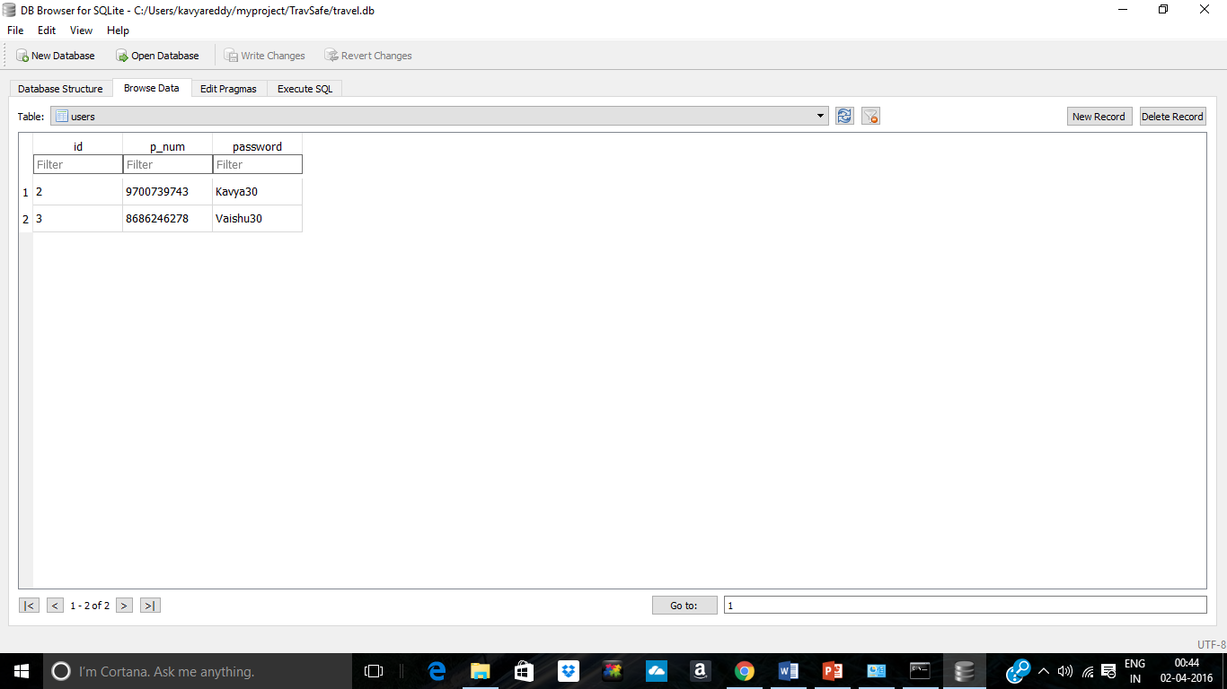
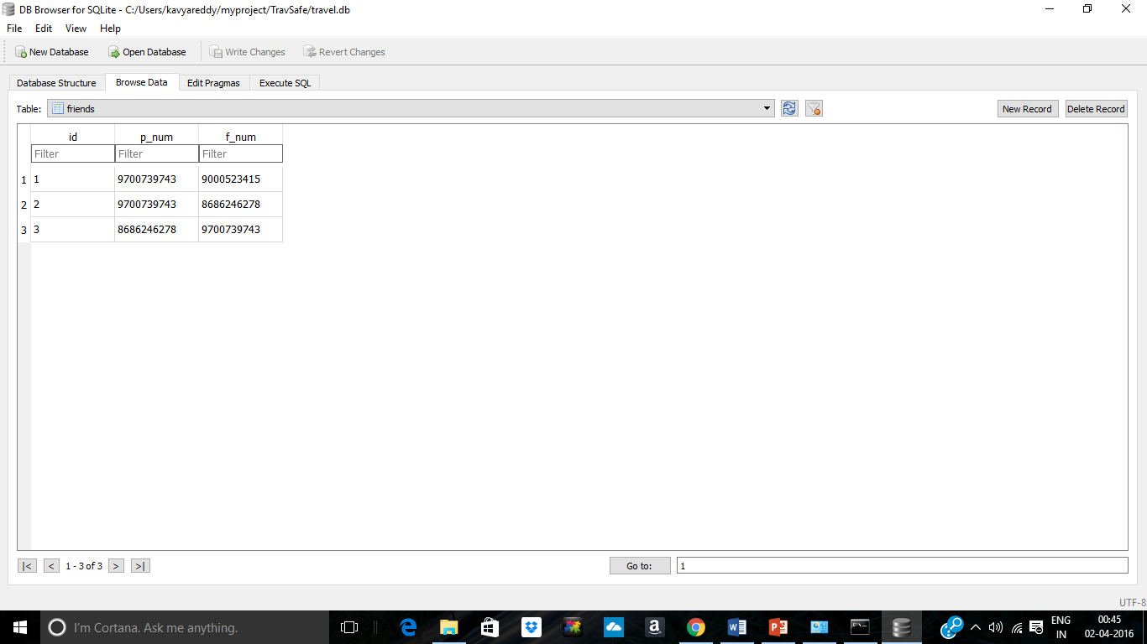
Data stored in the tables

Slide 10
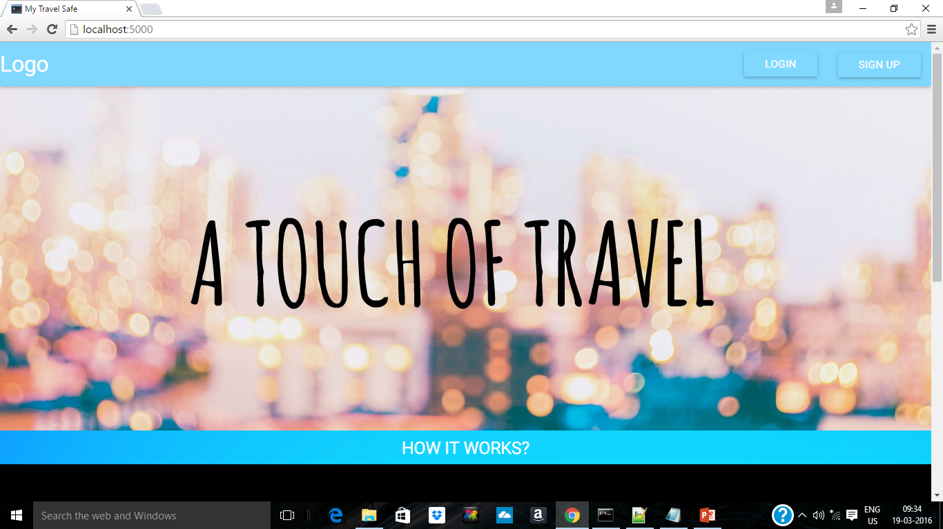
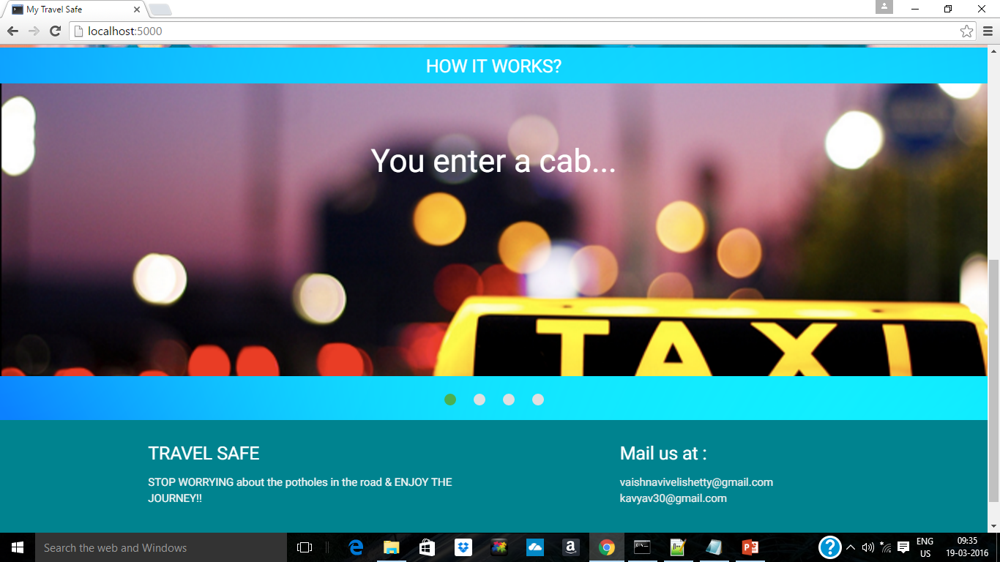
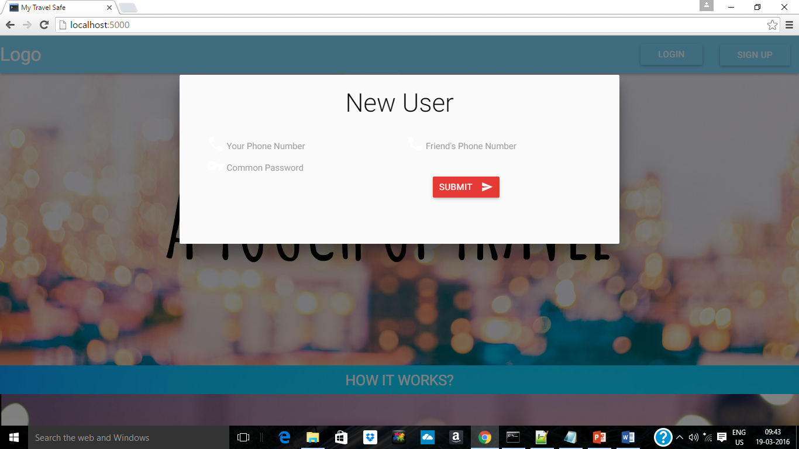
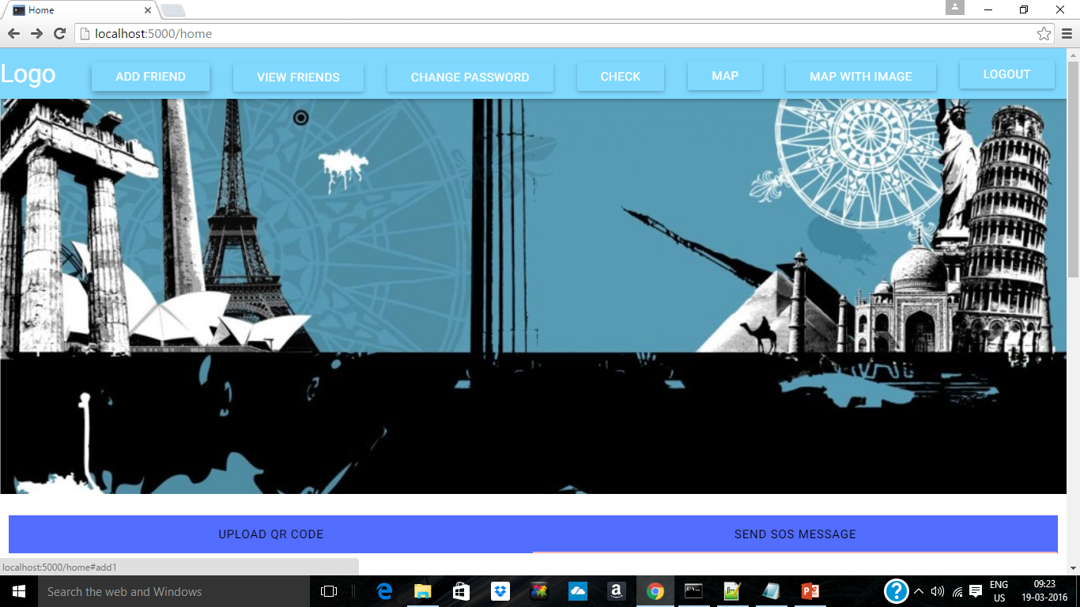
USER INTERFACE

Slide 11
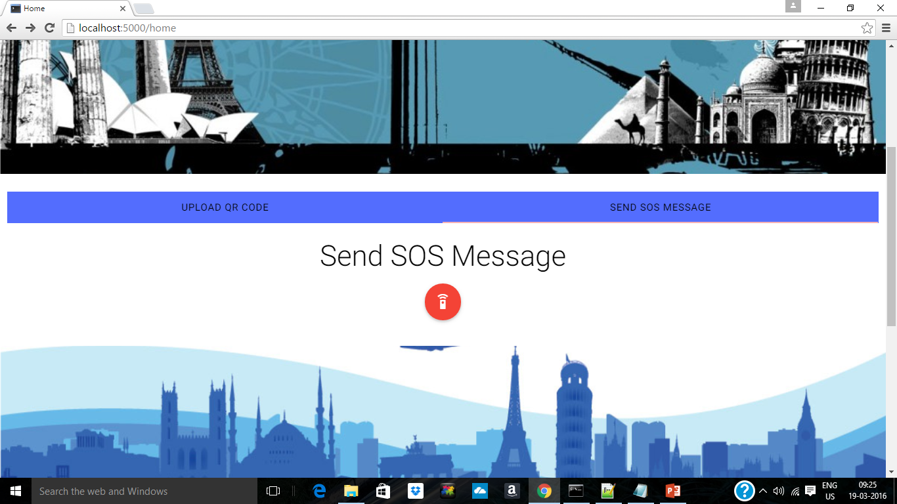
2 Key Functionalities
Uploading QR Code
Sending SOS message

Slide 12
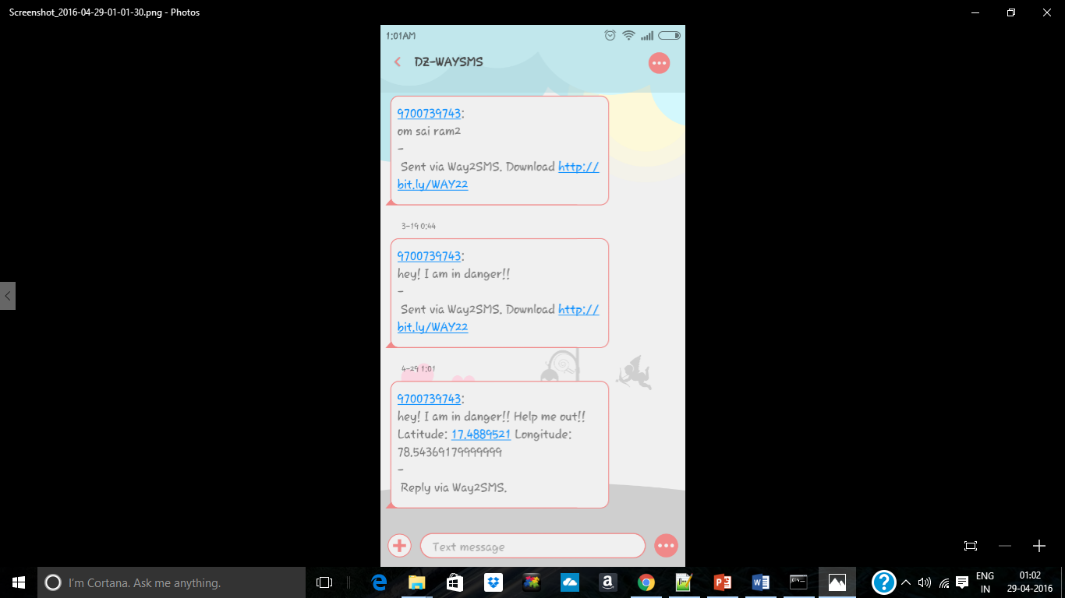
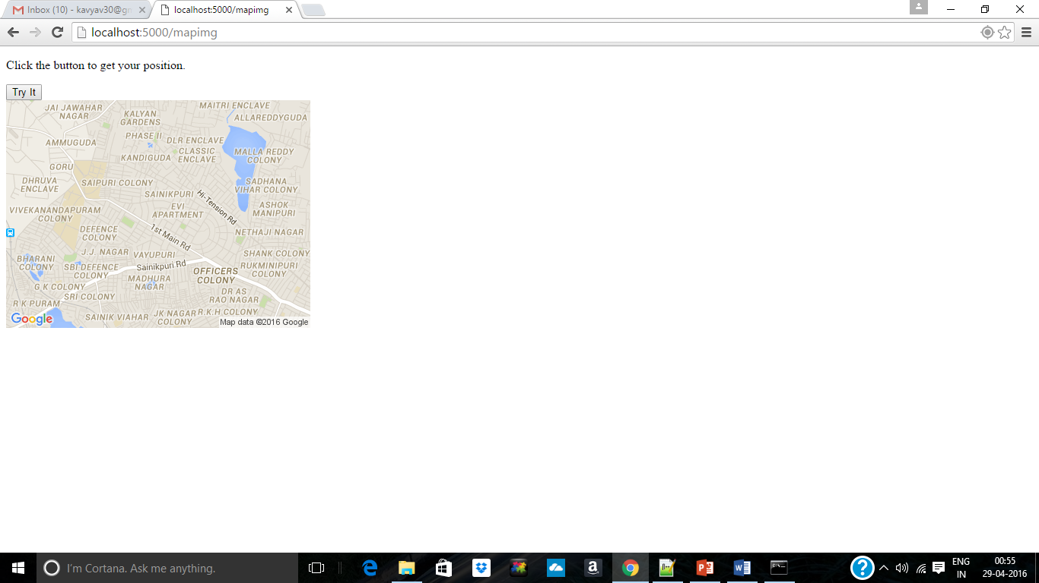
SOS and Map

Slide 13
Requirements
Language Used: Python
Database: SQLITE
Front-end: CSS, HTML, JS
1 GB RAM
Operating System: Windows

Slide 14
Travel Safe is our effort to ensure your safety
References:
www.flask.pocoo.org
www.codecademy.com
www.w3schools.com
www.google.com

Slide 15
Thank You

